Slide 1
Enhancing Real Estate Appraisals:
Machine Learning Approach
Presented by: Gerry Gumelar Karmana

Slide 2
OUR COMPANY
Empower your real estate decisions with our advanced machine learning models. We deliver highly accurate property valuations, enabling you to optimize pricing, improve appraisals, and maximize investments.
Our solution helps you predict property values with exceptional accuracy, reducing uncertainty and enhancing your decision-making process.
KYROS
Business Inteligence

Slide 3

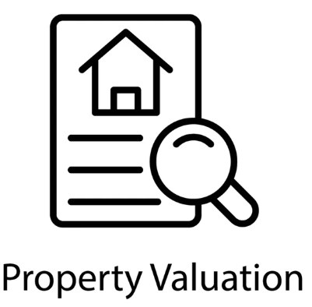

BUSINESS PROBLEM : Real Estate Appraisal
How to determine a value of the real estate ?
Price per Square foot / Price per Square Meter (Land Approach)
Comparative Market Analysis (CMA)
Income Approach
Professional Appraisal

Slide 4



BUSINESS PROBLEMS EFFECTS
TIME CONSUMING
Requires A lot of salesperson & manpower
Inefficient by not having the immediate result
frequently can be constrained to specific case or properties

Slide 5


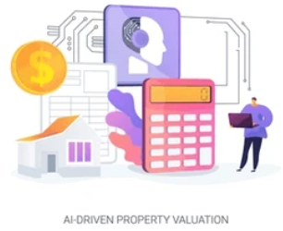
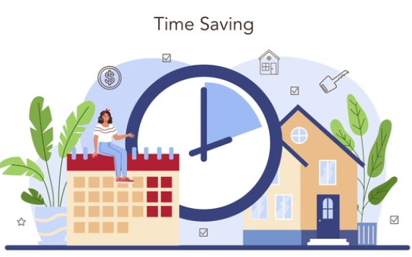
GOALS
Providing a tool to assist agents set baseline reliable & faster estimation for property prices
"Imagine being able to confidently price every listing, knowing you're maximizing value and minimizing time on the market."
"Stop wasting hours manually researching comps. Get accurate price estimates in seconds and close that deal."

Slide 6



Who gets the benefits of The Machine Learning Model
Real Estate Property Agents / Appraisers
IT Department

Slide 7
CONTEX & METRIC EVALUATION
Demonstration Model With Case Studies | Metric Evaluation
Housing census of California States (CA), 1990. The data set also features in by Pace, R. Kelley, and Ronald Barry. "Sparse spatial autoregressions." Statistics & Probability Letters 33.3 (1997): 291-297. With the data given we would like to proposed a featured model of machine learning to gain prediction using regression method and achieve the prediction of median house value from across CA states. | Mean Absolute Error (MAE): The average difference between the predicted price and the actual sales price. Lower is better Root Mean Squared Error (RMSE): Similar to MAE but gives more weight to larger errors. Lower is better. Mean Absolute Percentage Error (MAPE): measures the average percentage error of predictions.

Slide 8
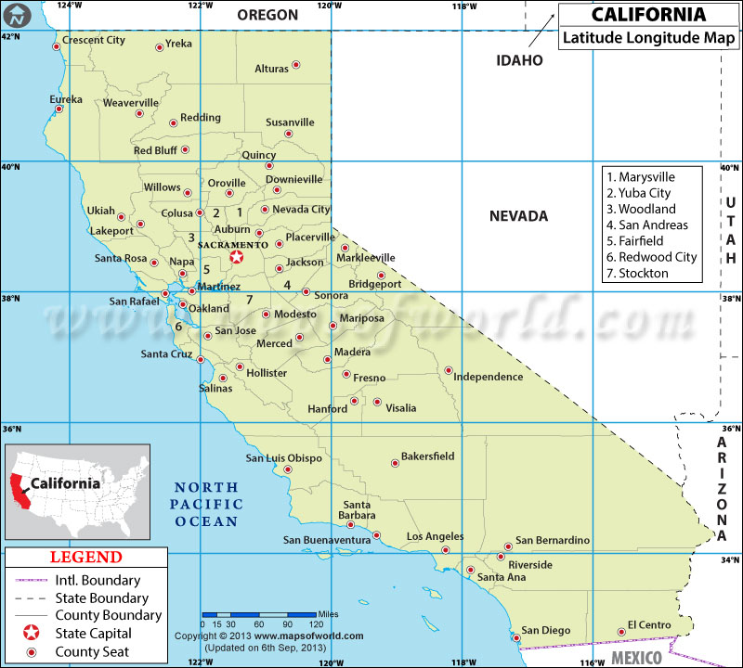
DATA UNDERSTANDING
INFORMATION ABOUT DATA SET
1. longitude: A measure of how far west a house is; a higher value is farther west 2. latitude: A measure of how far north a house is; a higher value is farther north 3. housing_Median_Age: Median age of a house within a block; a lower number is a newer building 4. total_Rooms: Total number of rooms within a block 5. total_Bedrooms: Total number of bedrooms within a block 6. population: Total number of people residing within a block 7. households: Total number of households, a group of people residing within a home unit, for a block 8. median_Income: Median income for households within a block of houses (measured in tens of thousands of US Dollars) 9. median_House_Value: Median house value for households within a block (measured in US Dollars) 10. ocean_Proximity: Location of the house w.r.t ocean/sea
Data Set have 10 columns and 14448 rows, null duplicated item
Found 0.95% null data in total_bedrooms, due to low it’ll be removed

Slide 9
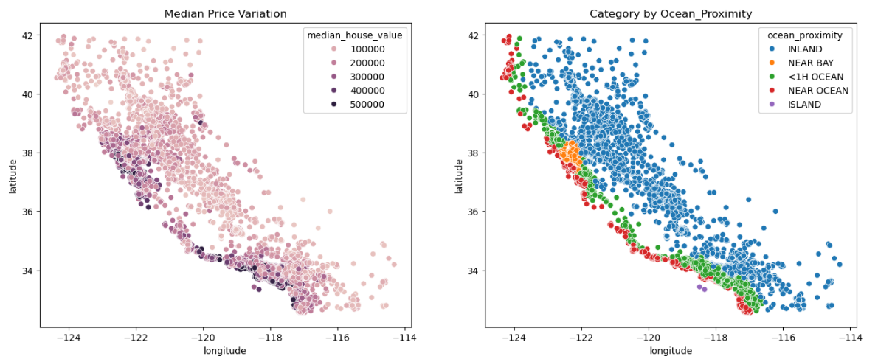
EXPLORATORY DATA ANALYSIS – MEDIAN PRICE VARIATION & CATEGORY in @ Longitude, Latitude
Highest price mostly situated NEAR OCEAN area | Price range 400 ~ 500K USD
Lowest price majority situated INLAND area | Price range 100 ~ 200K USD

Slide 10
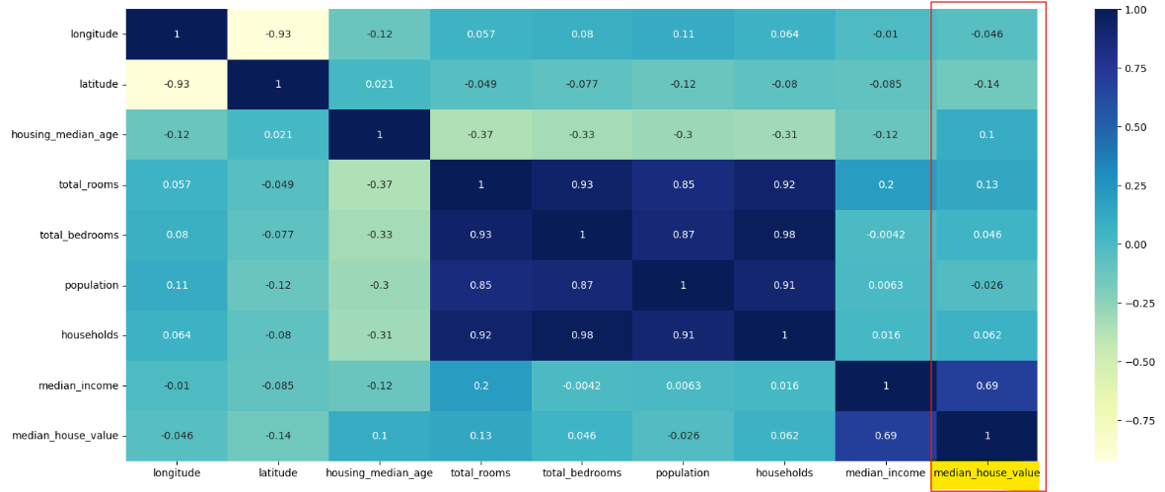
DATA UNDERSTANDING – HEAT MAP CORRELATION

Slide 11
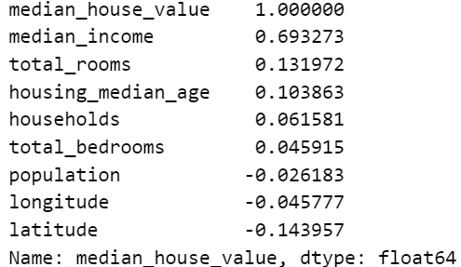
Highest Correlated Features – Median Income > Total_rooms > Housing_median_age
From the correlation value, it is shown that the house value or house price is highly correlated with the median income, which is totally conforms whereas the 'rich' people live is tend to be more expensive than others, followed by total rooms, and Housing_median_Age. While the correlation value 0.69, 0.13. and 0.10 for the most influential to median_house_value

Slide 12
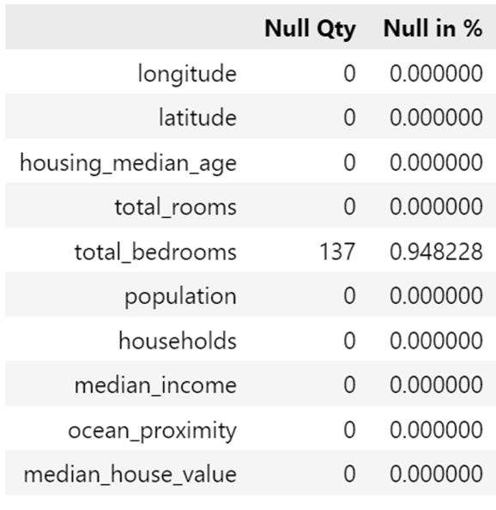
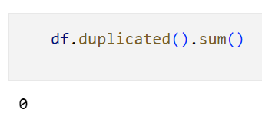
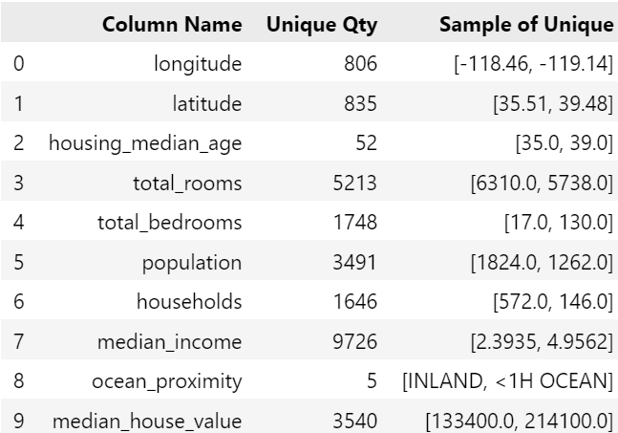

DATA CLEANING & PREPROCESSING
Checking duplicate = 0
Checking null qty
Checking unique sample
Data before = 14448
Data After = 13324
92.2 % Data Preserved
Total_bedrooms = 137 ~ 0.94% missing value
Found Categorical columns = ocean_proximity

Slide 13
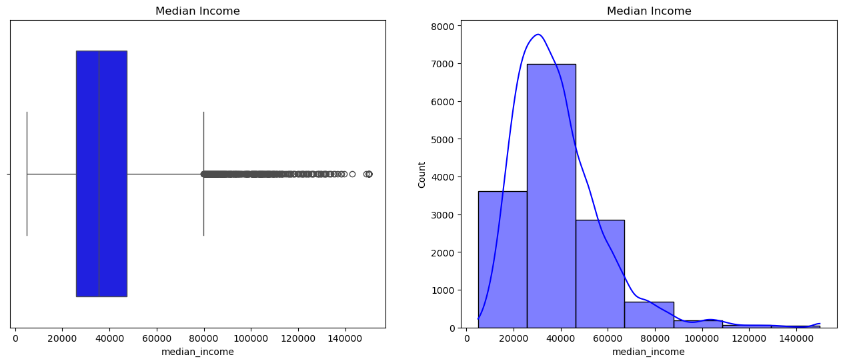
HANDLING OUTLIERS – MEDIAN INCOME
As seen from the box plot, there were many outliers in median income, the percentage of median income above $ 79861.5 is only 3.33 % which will not include to our model

Slide 14
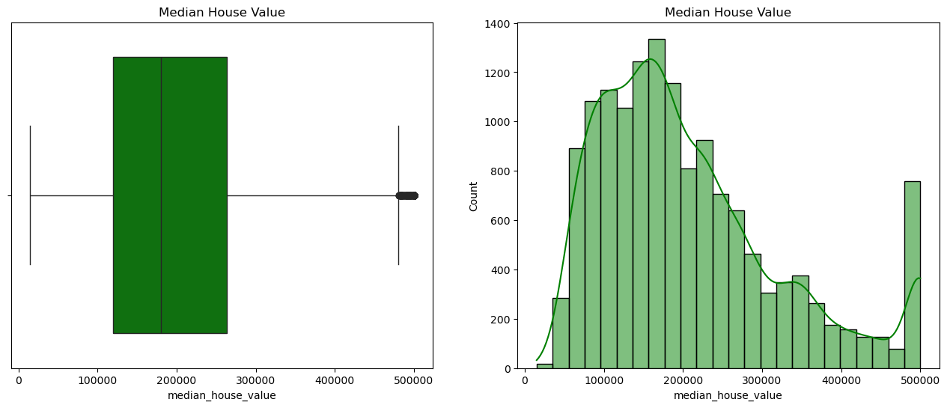

HANDLING OUTLIERS – MEDIAN HOUSE VALUE
Price > $ 480K
median house value ranging mostly $ 120.000 ~ 270.000 | the percentage of expensive house above $ 455.800 is 3.64 %.

Slide 15
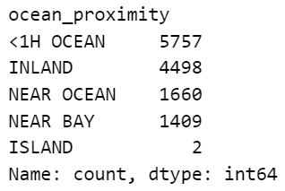
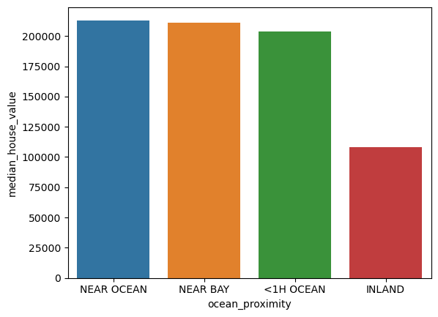
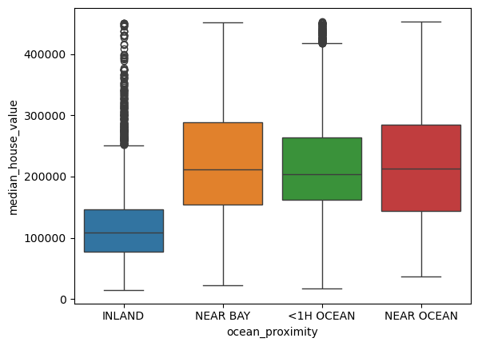
PRE-PROCESSING – CATEGORICAL DATA ‘OCEAN_PROXIMITY’
ISLAND category which only 2, this can be eliminated since the it is not sufficient to be included in the process of train, validation, and testing to our machine learning model.

Slide 16
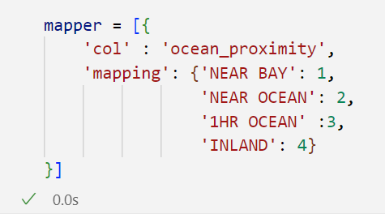
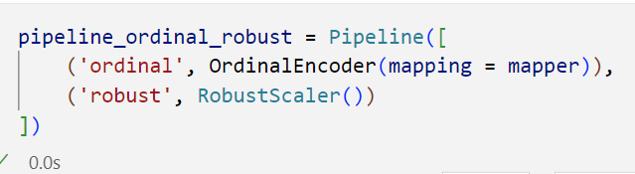
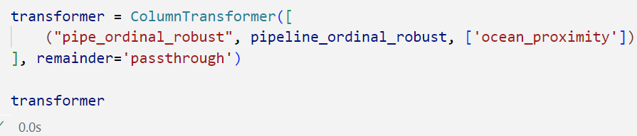
PRE PROCESSING – CATEGORICAL DATA ‘OCEAN_PROXIMITY’
We apply mapper to define hierarchical between each and other of the ocean proximity

Slide 17
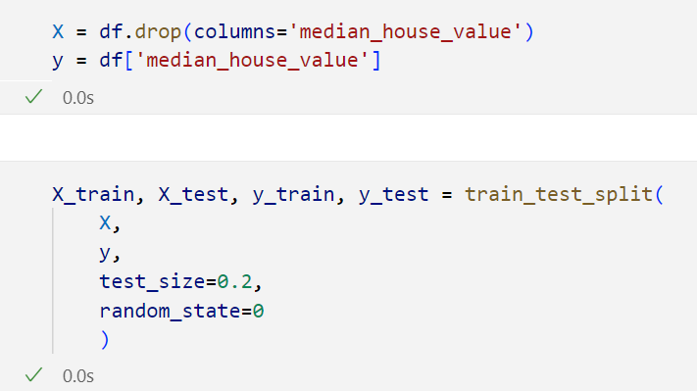
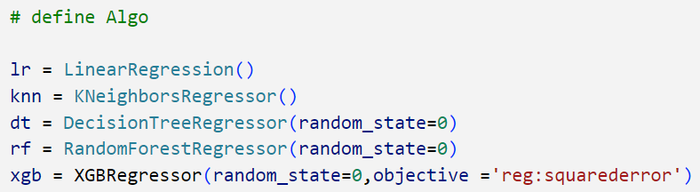
MODELING – SPLITTING & CROSS VALIDATION

Slide 18
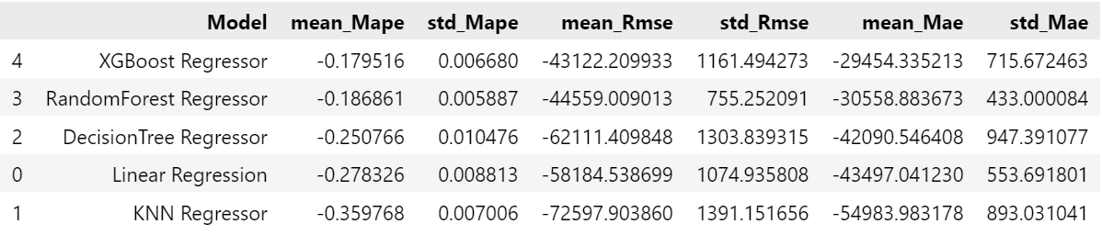
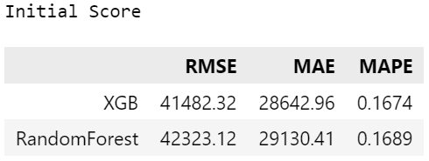
ALL BENCHMARK MODEL PERFORMANCE
model which have lowest value or even approaching zero (Mean MAPE, mean RMSE dan mean MAE) and,
model the most stable with lowest MAPE is XGBoostregressor, furthermore enhance by hyperparameter tuning

Slide 19
HYPERPARAMETER TUNING
These hyperparameters fine-tune a Gradient Boosting Machine (GBM):
max_depth and gamma limit tree complexity;
learning_rate and n_estimators control the model's learning pace and size;
subsample and colsample_bytree introduce randomness by using fractions of data and features for each tree;
reg_alpha simplifies the model through regularization.
Proper tuning of these parameters prevents overfitting and optimizes performance.
max_depth = list(np.arange(1, 11))
learning_rate = list(np.arange(1, 100)/100) n_estimators = list(np.arange(100, 201)) subsample = list(np.arange(2, 10)/10) gamma = list(np.arange(1, 11))
colsample_bytree = list(np.arange(1, 10)/10)
reg_alpha = list(np.logspace(-3, 1, 10))

Slide 20
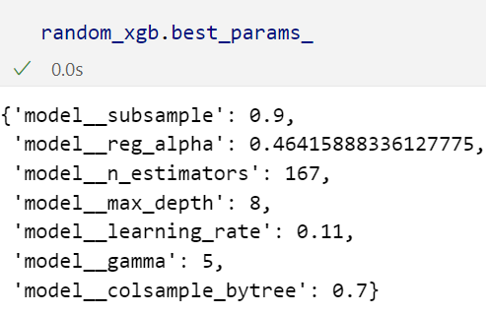
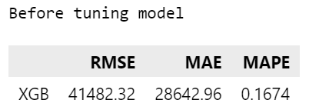
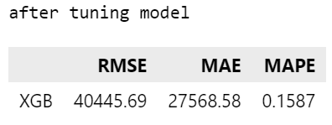
BENCHMARK BEST MODEL AFTER TUNING
Tuned model uses 167 trees with a maximum depth of 8, learning at a rate of 0.11. Regularization via `gamma` (5) and `reg_alpha` (0.464) prevents overfitting, while using 90% of the data and 70% of the features for each tree (`subsample` and `colsample_bytree`) adds randomness and robustness. This balanced configuration allows for effective learning without excessive complexity, promoting good generalization to unseen data.

Slide 21
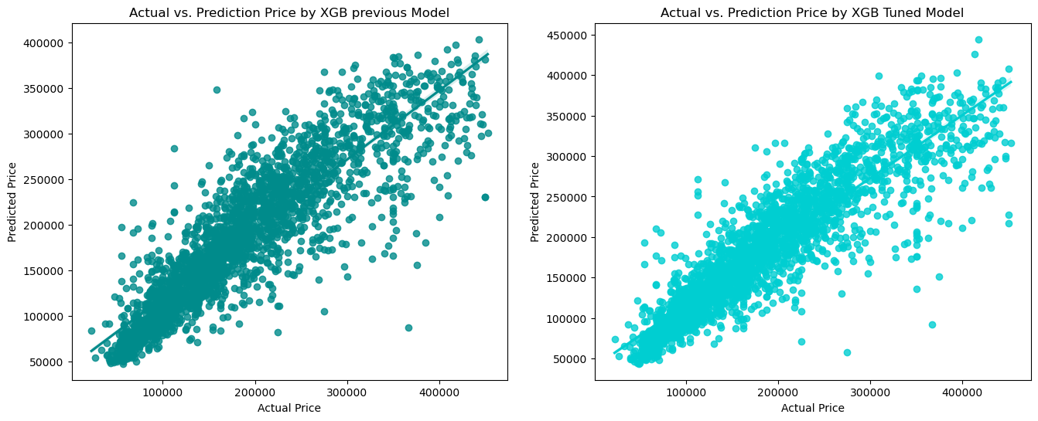
RESIDUAL PLOT
The tuned model outperforms the previous model by reducing prediction errors and improving the alignment of predicted prices with actual prices. Although both models show some scatter, the tuned model provides more reliable predictions, particularly for higher-priced properties.

Slide 22
CONCLUSION
As we have seen XGBoost model with aforementioned hyper tuned parameter The model built on average, the predicted median house values deviate from the actual values by approximately $40,445.70. according to RMSE. And the model's predictions are off by around $27,568.60 according to MAE. A MAPE of around 15-20% is generally considered acceptable in many forecasting scenario. This with obtained percentage 15.87%, error margin suggests that the model's predictions could be higher or lower than actual house values. Thing to keep in mind, and limitation of model built were not considered "The model's accuracy and results may be influenced by external factors such as the condition of the actual property, existing furniture, interior design, and other environmental elements. Discrepancies between the model and reality may occur due to these variations."

Slide 23
RECOMENDATION
Recommendations Based on Model Performance and Limitations: Incorporate Additional Features: To improve model accuracy, consider integrating more detailed features such as property condition, recent renovations, interior design quality, availability of amenities, and neighborhood-specific factors 2. Utilize Ensemble Methods or Hybrid Models: While XGBoost generally performs well, combining it with other models (e.g., Random Forest, Neural Networks)
Recommendations Based On Business Perspectives: Enhance Data Quality and Collection: Ensure that data used for training is up-to-date and accurately reflects the current market. Incorporating real-time or recent property data can help the model adapt to market fluctuations, improving predictive performance. 2. Collect Feedback from Real-World Use: Gather feedback from actual predictions and compare them with real market data to iteratively refine the model. This feedback loop can help improve future iterations.

